Slide 1
Climatiq_TBLWorkbook
File created on: 8/7/2023 12:17:11 PM

Slide 2
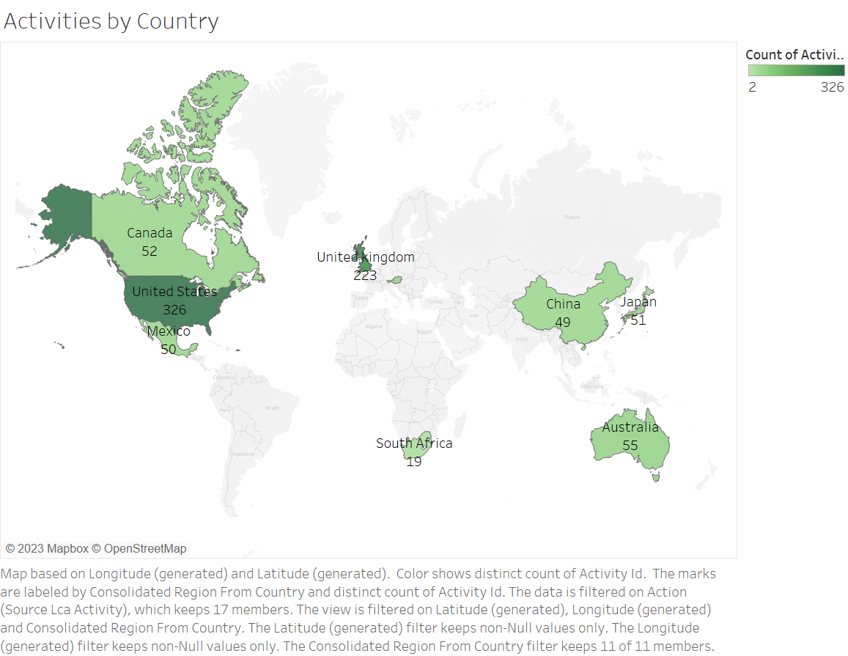

Slide 3
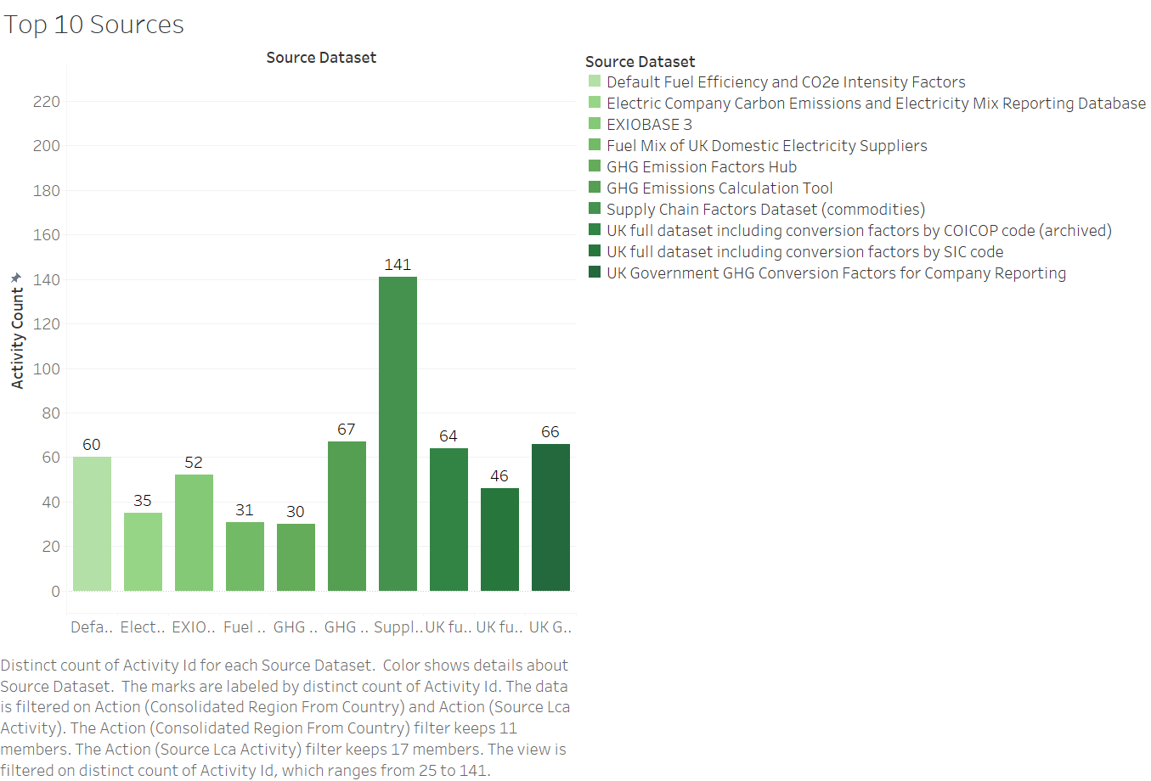

Slide 4
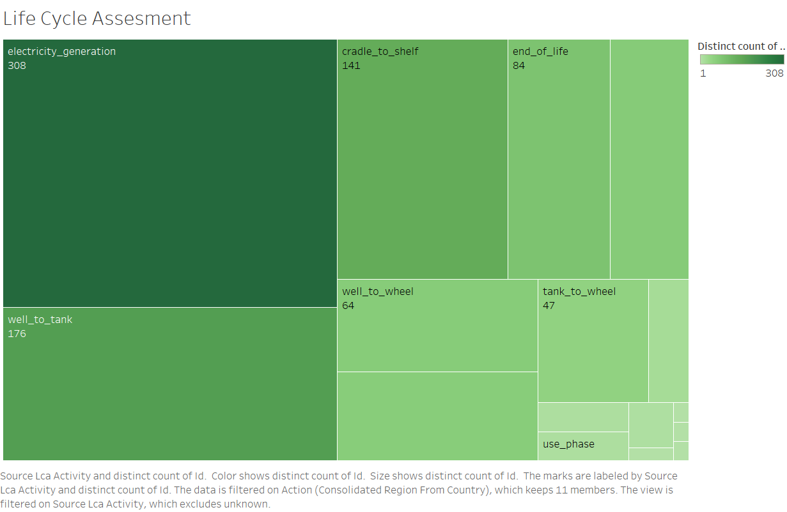

Slide 5
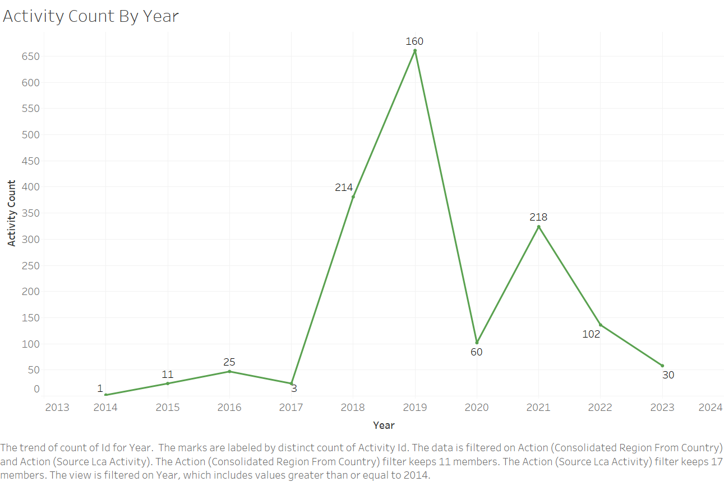

Slide 6


Slide 7
